Slide 1

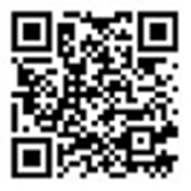

Annual Church Fundraising Campaign
Ways to Give
1. Online: www.ChristianServices.org
Venmo
@ColoradoChristianServices
  *Phone Confirmation Code: 4389
Check
Payable to Colorado Christian Services
Scan the QR Code Above
3959 E. Arapahoe Road, Suite 200, Centennial, CO 80122
303.761.7236 ChristianServices.org
* All donations are tax-deductible, as Colorado Christian Services is a registered 501(c)(3) nonprofit organization.

